Slide 1
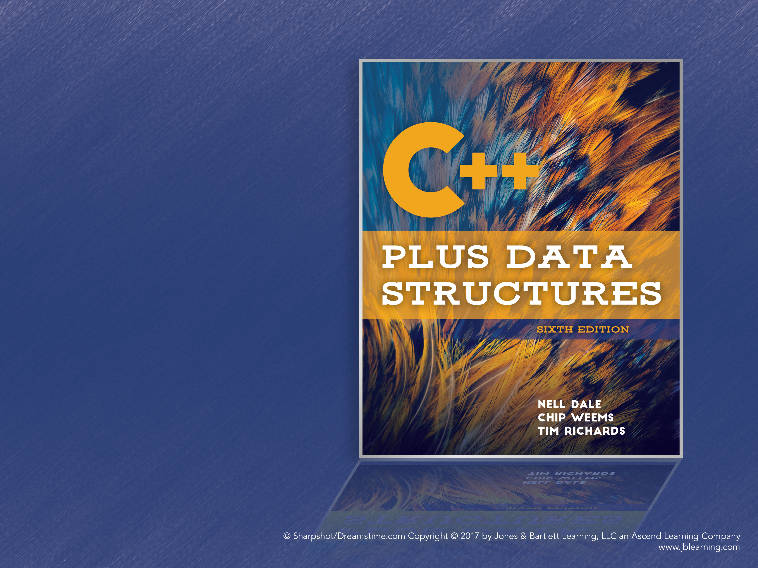
Chapter 7
Programming with Recursion

Slide 2
What Is Recursion?
Recursion: A power programming technique in which a function calls itself in order to divide work into smaller portions
Recursive call: When the function being called is the same as the one making the call
Direct Recursion: When a function calls itself
Indirect Recursion: When a chain of function calls leads back to the function that started it

Slide 3
The Classic Example
The factorial function, n!, is a classic example of recursion in mathematics
4! = 4 * 3 * 2 * 1 = 24
The recursive definition is:
n! = 1 if n = 0
n! = n * (n-1)! if n > 0
4! = 4 * 3! = 4 * 3 * 2! = 4 * 3 * 2 * 1! = 4 * 3 * 2 * 1 * 0! = 4 * 3 * 2 * 1 * 1 = 24

Slide 4
Recursion Terms
Recursive definition: When something is defined in terms of a smaller version of itself
Base case: The case for which the solution can be defined non-recursively (n! = 1 if n = 0)
General (or recursive) case: A case that is defined using recursion (n! = n * (n-1)! if n > 0)
Recursive algorithm: An algorithm described in terms of base cases and general cases

Slide 5
Programming Recursively
Recursion is a powerful tool when programming
Recursive solutions are often simpler and more elegant than other solutions
They allow programmers to solve small, divisible parts of a problem instead of having to wrangle the big picture
We’ll discuss when to use recursion later in this chapter

Slide 6
Factorial Code Example
// Iterative solution
int Factorial(int number) {
int fact = 1;
for (int count = 2; count <= number; count++) {
fact = fact * count;
}
return fact;
}
// Recursive solution
int Factorial(int number) {
if (number == 0) // Base case
return 1;
else // General case
return number * Factorial(number-1);
}

Slide 7
Recursive vs. Iterative Factorials
The iterative solution uses a looping construct (the for loop) while the recursive solution uses a branching construct (the if-else statement)
The iterative solution has two local variables, while the recursive solution only has the parameter
Sometimes the recursive solution use local variables, and sometimes they need several parameters

Slide 8
Verifying Recursive Functions
Walking through the execution of the function is time consuming, tedious, and doesn’t tell us if it works for all possible values
For example, try tracing the execution of Factorial(4)
A more general solution is necessary for verifying recursive functions

Slide 9
The Three-Question Method
Base-Case Question: Is there a non-recursive case in the method, and does it work correctly?
Smaller-Caller Question: Does each recursive call involve a smaller case of the problem, eventually leading to the base case?
General-Case Question: Assuming the recursive calls work correctly, does the rest of the function work correctly?
You should be able to answer yes to all three!

Slide 10
Three Questions for Factorial
Base-Case Question: The base case occurs when n = 0, and it returns 1 with no further recursion.
Smaller-Caller Question: Each recursive call subtracts 1 from n. This will eventually reach 0.
General-Case Question: Assuming Factorial(n-1) returns the correct answer, n * Factorial(n-1) corresponds with the mathematical formula.

Slide 11
Writing Recursive Functions
The general approach is:
Get an exact definition of the problem
Determine the size of the problem to be solved in each recursive call
Identify the base cases
Identify the general cases and the necessary recursive calls

Slide 12
Example: Searching in a List
Problem: Check if a particular value is in a list.
Recursive solution: Return (value is in the first position?) OR (value is in the rest of the list?)
How do we search the rest of the list? By recursively calling the ValueInList function!
Function: bool ValueInList (list, value, index)
Now consider the process above: What are the base cases and the general cases?

Slide 13
Example: Searching in a List (cont.)
Base case: The item is at the given index. Return true.
General case: The item is in the rest of the list. Recursively call ValueInList (list, value, index+1).
Is that it? What if the item is not in the list?
Base case: The end of the list has been reached. (index == length – 1) Return false.

Slide 14
Example: Searching in a List (cont.)
bool ValueInList(ListType list, int value, int startIndex)
{
if (list.info[startIndex] == value)
return true; // Base case 1
else if (startIndex == list.length-1)
return false; // Base case 2
else return ValueInList(list, value, startIndex+1);
}

Slide 15
Example: Searching in a List (cont.)
Does this function pass the Three Questions?
Base Case: The value is found, and the function returns true. In the second case, the search reaches the end of the list and returns false.
Smaller Caller: Each call increments the index.
General Case: The base cases are simple enough to be obviously correct, so the general case will proceed while the value is not found and the rest of the list needs to be checked.

Slide 16
Simplifying Solutions with Recursion
How many combinations of 5 books can be made from a group of 20 books? (“n choose k”)
Size: Size of the group (n) and number of members in each group (k)
Base Case: if members == 1, return group
Base Case: if members == group, return 1
General Case: Return Combinations (group-1, members-1) + Combinations (group-1, members)

Slide 17
Combinations Code
int Combinations(int group, int members)
// Pre: group and members are positive.
// Post: Function value = number of combinations of
// members size that can be constructed from the total
// group size.
{
if (members == 1)
return group; // Base case 1
else if (members == group)
return 1; // Base case 2
else
return (Combinations(group-1, members-1) +
Combinations(group-1, members));
}

Slide 18
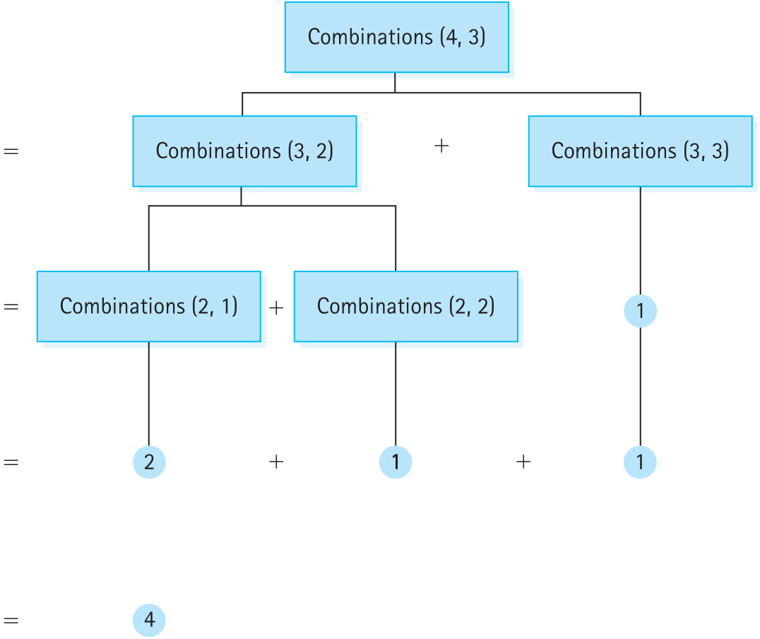
Combinations
Figure 7.2 Calculating Combinations(4,3)

Slide 19
Recursive List Processing
Another example of recursion: Printing the items of a linked list.
This seems trivial. Instead, let’s try printing the list in reverse.
Is this possible with iteration? Yes, if there are methods for iterating backwards through the list.
Recursion doesn’t need that.

Slide 20
Problem Definition
Problem: Print the elements of a list in reverse order.
Size: The number of elements in the list.
Base Case: If the list is empty, do nothing.
General Case: RevPrint the list pointed to by listPtr->next, then print listPtr->info

Slide 21
RevPrint Code
// Prints the list in reverse order
void RevPrint(NodeType* listPtr){
if (listPtr != NULL) {
RevPrint(listPtr→next);
std::cout << listPtr->info <<
std::endl;
}
}

Slide 22
RevPrint: Three Questions
Base Case: Not explicit in the code. Nothing is done if the list pointer is NULL.
Smaller-Caller: Each recursive call walks another step down the list, heading towards the final NULL pointer.
General Case: Assuming the recursive call works correctly, the rest of the list will have been printed before the current value is.

Slide 23
Recursive Binary Search
Chapter 4 showed an iterative binary search
Recall that binary search has a list to search, a target value, and the indices to search between
It is essentially a recursive algorithm: Each step of the binary search algorithm cuts the search area in half by changing the indices

Slide 24
Recursive Binary Search (cont.)
Problem: Search the area for the target value
Size: The number of items between the two indices
Base Cases:
The target value is in the middle of the list
There is no more area to search (end > start)
General Case: Search the lower or higher half of the list depending on the middle value

Slide 25
Recursive PutItem and DeleteItem
Items at the very beginning or end of the list are edge cases for these two functions
Recursion lets us program them as if we only have the edge cases: Either insert/remove the front of the list, or insert into an empty list
Instead of being recursive themselves, write two recursive helper functions, Insert and Delete

Slide 26
Recursive List Insertion
Problem: Insert an item into a sorted list
Size: The number of items in the list
Base Cases:
If the list is empty, insert the item
If the item is less than listPtr->info, insert the item as the first node
General Case: Insert(listPtr->next, item)

Slide 27
Recursive Item Deletion
Problem: Delete a target item from the list
Size: The number of items in the list
Base Case: If listPtr->info == item, delete the node pointed to by listPtr
General Case: Delete(listPtr->next, item)

Slide 28
Recursive PutItem and DeleteItem
Of course, both functions must update the list’s links
Insert and Delete need a reference to the list pointer in order to be able to update the list
NodeType<ItemType>*& listPtr
Otherwise, any changes to listPtr will not be carried through to the caller

Slide 29
Recursive Insert
template<class ItemType> void Insert(NodeType<ItemType>*& listPtr, ItemType item) { if (listPtr == NULL || item < listPtr→info) { // Save current pointer. NodeType<ItemType>* tempPtr = listPtr; // Get a new node. listPtr = new NodeType<ItemType>; listPtr->info = item; listPtr->next = tempPtr; } else Insert(listPtr->next, item); }

Slide 30
How Recursion Works
Some programming languages do not support recursion. Why?
To understand this, let’s detour and talk about binding, or associating a memory address with a variable name.
Binding can occur at different times.
Static binding occurs at compile time
Dynamic binding occurs at run time

Slide 31
Static Binding
When a program is compiled, each variable is entered into a symbol table and bound to a memory address
Each reference to the variable name is replaced by the memory address
Function parameters and local variables are also bound to memory addresses at this time
This is also called static storage allocation

Slide 32
Symbol Table
Three variables are declared: int a, b, c;
The compiler binds them in the symbol table:
Symbol Address
a 0001
b 0002
c 0003
A statement such as: a = b + c;
Becomes: “Get value stored at 0002; Get the value stored at 0003; Store the sum in 0001”

Slide 33
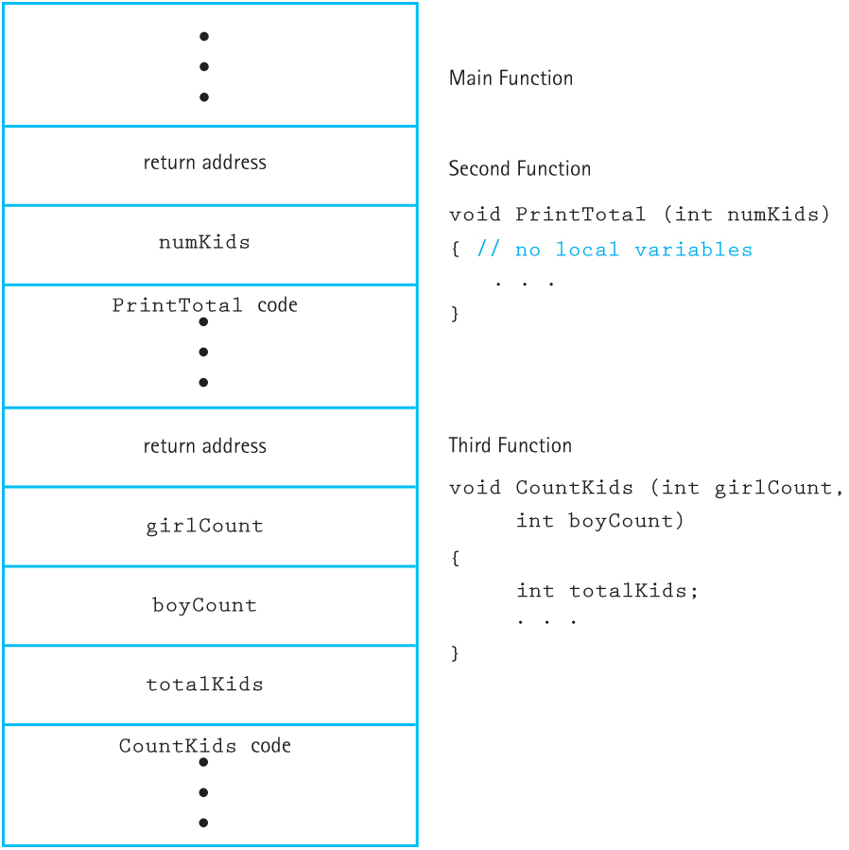
Static Binding: Memory Layout
Figure 7.4 Static allocation of space for a program with three functions

Slide 34
Static Binding and Recursions
Each parameter and local variable has a single, fixed memory address associated with it
A recursive function call would overwrite the variables of the previous call
Each recursive call needs memory to store its own variables
Therefore languages that only have static storage allocation cannot support recursion

Slide 35
Dynamic Binding
Dynamic Storage Allocation: Variable names are bound to memory addresses at run time.
The compiler references variables by their offsets instead of by exact addresses. The correct addresses are calculated during execution using these offsets.
But where are the variables and parameters for functions stored?

Slide 36
Activation Records
Functions need to store local variables, parameters, and return address
Return address: Where execution returns to, once execution of the function has completed
Activation Record: A record used at run time to store information about a function, such as its variables, parameters, return address, and register values
Also called a stack frame

Slide 37
Activation Records (cont.)
Every function call creates a new activation record
The activation record is deleted once the call is complete
The code for creating and releasing activation records is inserted automatically by the compiler

Slide 38
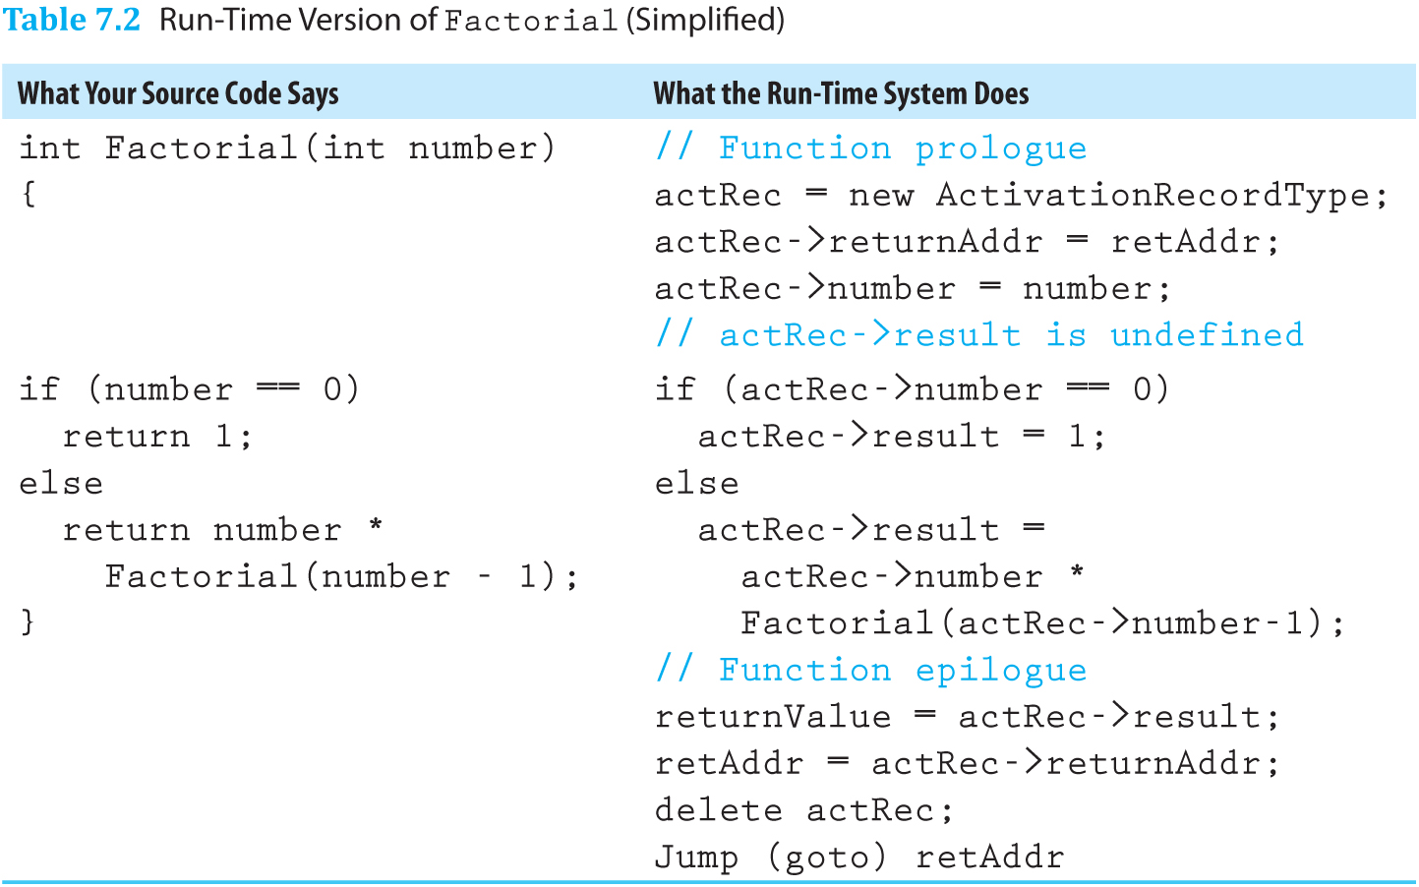
Example: Factorial Stack Frame
Table 7.2 Run-time Version of Factorial (Simplified)

Slide 39
Run-Time Stack
Activation records are pushed onto the run-time stack when the function is called
Each call pushes another record onto the stack
This gives recursive function calls their own memory for storing variables
It also clearly shows the order of recursive functions calls

Slide 40
Run-Time Stack of Factorial(4)
Let’s walk through an example using Factorial
At address 5200 is the statement:
answer = Factorial(4);
This starts the recursive algorithm by pushing an activation record onto the stack
The recursive call inside Factorial is at address 1010:
return number * Factorial(number-1);

Slide 41
Run-Time Stack of Factorial(4) (cont.)
Call Number | Number | Result | Return address
1 | 4 | ??? | 5200
The activation record contains the parameter (4), the result (unknown), and the return address (5200)

Slide 42
Run-Time Stack of Factorial(4) (cont.)
Call Number | Number | Result | Return address
1 | 4 | ??? | 5200
2 | 3 | ??? | 1010
The recursive calls continue, since the base case hasn’t been reached (“number == 0”)

Slide 43
Run-Time Stack of Factorial(4) (cont.)
Call Number | Number | Result | Return address
1 | 4 | ??? | 5200
2 | 3 | ??? | 1010
3 | 2 | ??? | 1010

Slide 44
Run-Time Stack of Factorial(4) (cont.)
Call Number | Number | Result | Return address
1 | 4 | ??? | 5200
2 | 3 | ??? | 1010
3 | 2 | ??? | 1010
4 | 1 | ??? | 1010

Slide 45
Run-Time Stack of Factorial(4) (cont.)
Call Number | Number | Result | Return address
1 | 4 | ??? | 5200
2 | 3 | ??? | 1010
3 | 2 | ??? | 1010
4 | 1 | ??? | 1010
5 | 0 | 1 | 1010
Here, the base case has been reached
We start popping the run-time stack, propagating the result back to the original call

Slide 46
Run-Time Stack of Factorial(4) (cont.)
Call Number | Number | Result | Return address
1 | 4 | ??? | 5200
2 | 3 | ??? | 1010
3 | 2 | ??? | 1010
4 | 1 | 1 | 1010
The result is calculated...

Slide 47
Run-Time Stack of Factorial(4) (cont.)
Call Number | Number | Result | Return address
1 | 4 | 24 | 5200
Until (skipping a few steps) the final result is calculated (24) and returned to address 5200
The result is stored at answer and the main method continues executing

Slide 48
Recursion Depth
The number of recursive calls constitutes the depth of recursion
Since recursion is another way of performing iterations, recursion depth can be thought of in terms of Big-O notation
The number of iterations and the recursion depth are both based on the size of the problem

Slide 49
Tracing Recursive Insert
template<class ItemType>
void Insert(NodeType<ItemType>*& listPtr, ItemType item)
{
if (listPtr == NULL || item < listPtr->info)
{
// Save current pointer.
NodeType<ItemType>* tempPtr = listPtr;
// Get new node.
listPtr = new NodeType<ItemType>;
listPtr->info = item;
listPtr->next = tempPtr;
}
else Insert(listPtr->next, item);
}

Slide 50
Tracing Recursive Insert (cont.)
Call number | listPtr | item | tempPtr | returnAddr
1 | 010 | 11 | ??? | R0
listPtr points to the list [7, 9, 13, 20]
Call: Insert(listPtr, 11)
11 > 7, so we drop into the else statement

Slide 51
Tracing Recursive Insert (cont.)
Call number | listPtr | item | tempPtr | returnAddr
1 | 010 | 11 | ??? | R0
2 | 014 | 11 | ??? | R1
listPtr points to the list [9, 13, 20]
11 > 9, so continue to the next call

Slide 52
Tracing Recursive Insert (cont.)
Call number | listPtr | item | tempPtr | returnAddr
1 | 010 | 11 | ??? | R0
2 | 014 | 11 | ??? | R1
3 | 018 | 11 | 020 | R2
listPtr points to the list [9, 13, 20]
11 < 13, so the element is inserted
The stack will then unwind and return to the original caller

Slide 53
Tracing Recursive Insert (cont.)
Before the recursive call, the list looked like:
Insert the image of the list at the bottom of page 465 here
During call 3, listPtr and tempPtr point to:
Insert the image in the middle of page 467 here

Slide 54
Recursive Quick Sort
Quick Sort is an algorithm inspired by the idea that it is easier to sort two smaller lists than one large one: “divide and conquer.”
This is a recursive strategy. The list is continually split into smaller lists, which are then passed to Quick Sort again.
Recursion stops when the lists cannot be split, i.e., there is only one or zero elements left.

Slide 55
Quick Sort Algorithm
If there is more than one element in the list:
Select a value to split the list on (splitVal)
Split the list such that:
values[first] to values[splitPoint-1] <= splitVal
values[splitPoint] = splitVal
values[splitPoint+1] to values[last] > splitVal
Quick sort the left half (the lower half)
Quick sort the right half (the higher half)

Slide 56
Recursive Quick Sort
Problem: Sort an array-based list of values
Size: values[first] to values[last]
Base Case: If there are fewer than 2 items in values[first] to values[last], do nothing
General Case: Split the array and quick sort the two halves

Slide 57
Quick Sort Code
template<class ItemType>
void QuickSort(ItemType values[], int first, int last)
{
if (first < last)
{
int splitPoint;
Split(values, first, last, splitPoint);
// values[first]..values[splitPoint-1] <= splitVal
// values[splitPoint] = splitVal
// values[splitPoint+1]..values[last] > splitVal
QuickSort(values, first, splitPoint-1);
QuickSort(values, splitPoint+1, last);
}
}

Slide 58
Quick Sort: Three Questions
Base Case: Yes, when there’s at most one element left (first >= last) the function does nothing
Smaller-Caller: Yes, Split divides the array into smaller segments, and those segments are then sorted
General Case: Yes, assuming Split works, eventually the base case will be reached

Slide 59
Quick Sort: Splitting
A simple splitting algorithm walks through the array and swaps values that are out of place
This is accomplished by using two indices, first and last, that start at front and back of the list
Remember, we aren’t sorting, just making sure the values are on the correct side of the split
This algorithm is correct, but may be slow

Slide 60
Quick Sort Splitting Algorithm
Choose the split value.
Advance first until it reaches a value that is greater than the split value.
Move last backward through the list until it reaches a value that is less than the split value.
Swap these two values and advance the two indices one space.
Repeat until first and last meet.

Slide 61
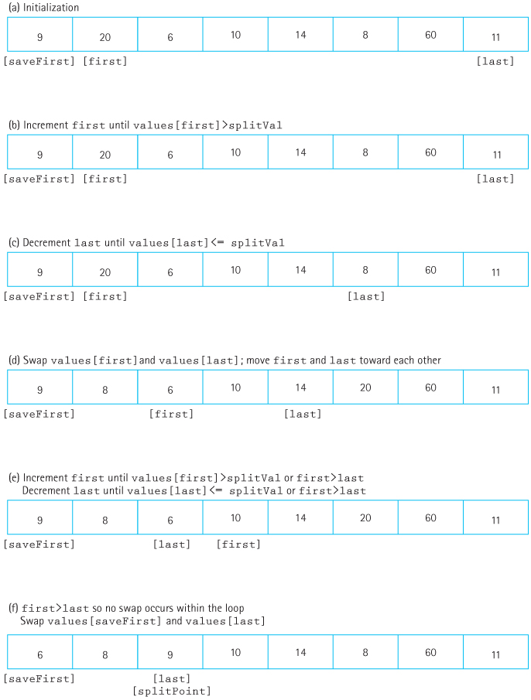
Figure 7.7 Function split (a) Initialization (b) Increment first until values[first]>splitVal (c) Decrement last until values[last]<= splitVal (d) Swap values[first] and values[last]; move first and last toward each other (e) Increment first until values[first]>splitVal or first>last Decrement last until values[last]<=splitVal or first>last (f) first>last so no swap occurs within the loop Swap values[saveFirst] and values[last]

Slide 62
Choosing a Split Value
The first value in the list is straightforward and typically works well
Sometimes the list is already partially sorted, in which case choosing the middle value of the list is a better choice
Different splitting strategies may benefit from different split values

Slide 63
Debugging Recursive Routines
Recursive methods can have confusing and unique errors
For example, it may recurse forever, causing the run-time stack to run out of space
This can also happen just from a method needing to recurse more times than the system can handle
The Three-Question method is a helpful tool for thinking about and verifying recursive routines

Slide 64
Removing Recursion
Sometimes recursion isn’t the best method
The language doesn’t support it
It uses too much space or time
An iterative solution is simpler (unusual but not impossible)
Two techniques can be used to turn a recursive algorithm into a non-recursive one: iteration and stacking

Slide 65
Iteration
Tail Recursion: When the recursive call is the last statement to be executed in a function
When the recursive call returns, the calling function immediately returns the value
This can be easily turned into a loop by using the base case conditions as loop conditions
Some compilers automatically optimize tail recursion in this way

Slide 66
Stacking
Recursive methods that aren’t tail recursive perform an action after receiving the result of the recursive calls
e.g., RevPrint prints the item after the rest of the list has been printed
This can be emulated by using a stack as intermediate storage for results
e.g., Push each list value to a stack, then pop and print them until the stack is empty

Slide 67
Deciding When to Use Recursion
Efficiency: Generally, recursive solutions need more computation time, memory, and overhead
Each recursive call copies value parameters to the stack, for example
Some recursive algorithms are inherently computationally inefficient, such as the Combinations algorithm earlier in this chapter

Slide 68
Deciding When to Use Recursion (cont.)
Clarity: For many problems, the recursive solution is simpler and easier to write
Compare the two versions of RevPrint, for example
Programmer efficiency should not be ignored
Sometimes a tradeoff between development time and execution time is well worth it, especially in a team setting

Slide 69
When to Use Recursion
The depth of recursion is relatively shallow: O(logN) is great, and even O(N) can be fine.
The recursive version does about as much work as the non-recursive version.
e.g., Both versions of Binary Search are O(logN), while Combinations is O(2N) recursively vs. O(N) iteratively.
The recursive version is shorter and simpler.

